Slide 1
Innovative Tourism Service Provider and Evaluator
Submitted in the partial fulfillment for the award of the degree of
BACHELOR OF ENGINEERING
IN
CSE-AIML
Submitted by:
Tanshi Verma
20BCS6812
Yash Raj Gupta
20BCS6812
Pranjal Mohana
20BCS6756
Yogesh Kamboj
20BCS6811
Aahish Aahan
20BCS6731
Under the Supervision of:
Lata Gupta(E13365)
Department of AIT-CSE
DISCOVER . LEARN . EMPOWER

Slide 2
Outline
Introduction to Project
Problem Formulation
Objectives of the work
Methodology used
Results and Outputs
Conclusion
Future Scope
References

Slide 3
Introduction to Project
Tourism has long been a catalyst for cultural exchange, economic growth, and cross-border connections.
Every year, millions of travellers embark on journeys to explore new destinations, experience diverse cultures, and create lasting memories.
However, amidst the excitement of exploration, tourists often encounter challenges that can taint their experiences – from exorbitant overcharges to misleading information and even instances of fraud.
These issues not only mar the reputation of the tourism industry but also discourage potential travellers from fully embracing the joys of exploration.
In response to these challenges, our project aims to revolutionize the way tourists interact with and evaluate service providers across the nation.
By developing a cutting-edge digital solution, we aspire to address the crucial concerns of overcharging, duping, and a lack of transparent information that plague the tourism landscape.
This project envisions an ecosystem where tourists are empowered with accurate, real-time information and service providers are incentivized to uphold the highest standards of transparency and quality.

Slide 4
Problem Formulation
The tourism industry is a vibrant tapestry that weaves together cultures, economies, and memories. However, within this captivating landscape, several challenges persist, tarnishing the experiences of traveller's and posing obstacles to the industry's growth. The problem at hand revolves around incidents of tourist overcharging, duping, and the overarching lack of transparent and accurate information. These issues have prompted the need for a comprehensive and innovative solution that safeguards the interests of tourists while promoting ethical practices within the tourism sector.
Overcharging and Exploitation
Lack of Transparent Information
Duping and Misrepresentation
Inadequate Quality Assurance
Digital Literacy and Accessibility Disparities
The Quest for an Innovative Solution

Slide 5
Objectives of the Work
The primary objective of the proposed project, the "Innovative Service Provider Evaluation System," is to address and mitigate the prevalent challenges faced by tourists, including overcharging, duping, and the lack of transparent and accurate information when engaging with various tourism service providers.
Enhancing Transparency: Develop a transparent platform that provides accurate and real-time information to tourists about various service providers, including pricing, services offered, and customer reviews.
Preventing Overcharging: Implement mechanisms to prevent overcharging by service providers, ensuring that tourists are charged fair and reasonable prices for the services they receive.
Combatting Fraud and Misleading Information: Create safeguards to identify and prevent instances of fraud and misleading information, safeguarding tourists from dishonest practices.
Empowering Tourists: Empower tourists with the ability to make informed decisions about service providers, enabling them to choose reliable and trustworthy options that align with their preferences and budgets.

Slide 6
Methodology used
1. Project Planning and Research:
Define Project Scope: Clearly outline the features and functionalities of the system. Determine the geographical area it will cover, types of service providers, and services to be included.
Market Research: Understand the existing tourism industry, identify competitors, and analyze user preferences and pain points.
2. Technology Selection:
Choose Appropriate Technologies: Select suitable programming languages, frameworks, and databases for building the digital platform. Consider factors such as scalability, security, and user experience.
3. System Design and Development:
Database Design: Create a robust database schema to store service provider information, user profiles, reviews, and ratings.
Platform Development: Develop the digital platform, focusing on user-friendly interfaces for both tourists and service providers. Implement features like search functionality, user reviews, and secure payment gateways.

Slide 7
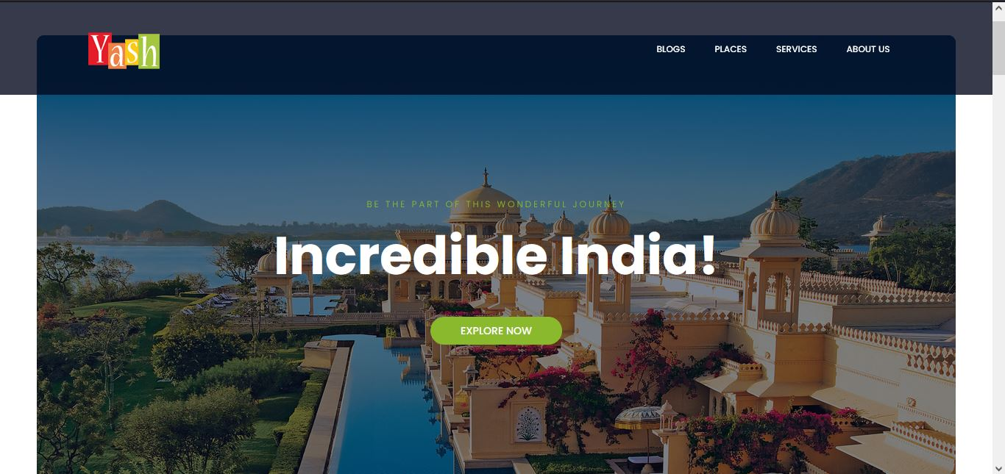
Methodology used
4. Data Collection and Verification:
Service Provider Onboarding: Establish a verification process for service providers to ensure the authenticity of their offerings.
User Reviews: Implement a system for collecting genuine and verified user reviews to maintain credibility.
5. Implementing Transparency Measures:
Price Transparency: Develop algorithms or guidelines to display fair price ranges for different services based on market rates and service quality.
Service Details: Ensure accurate and comprehensive information about services, including descriptions, photos, and amenities.
6. Quality Control and Monitoring:
Quality Assurance Testing: Conduct rigorous testing to identify and fix bugs, ensuring a seamless user experience.
Monitoring and Analytics: Implement tools to monitor user interactions, track popular services, and gather user behavior data for continuous improvement.

Slide 8
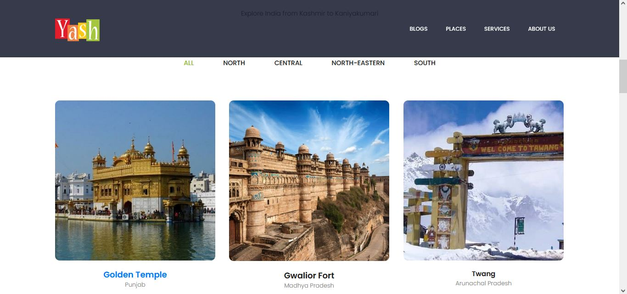
Results and Outputs

Slide 9
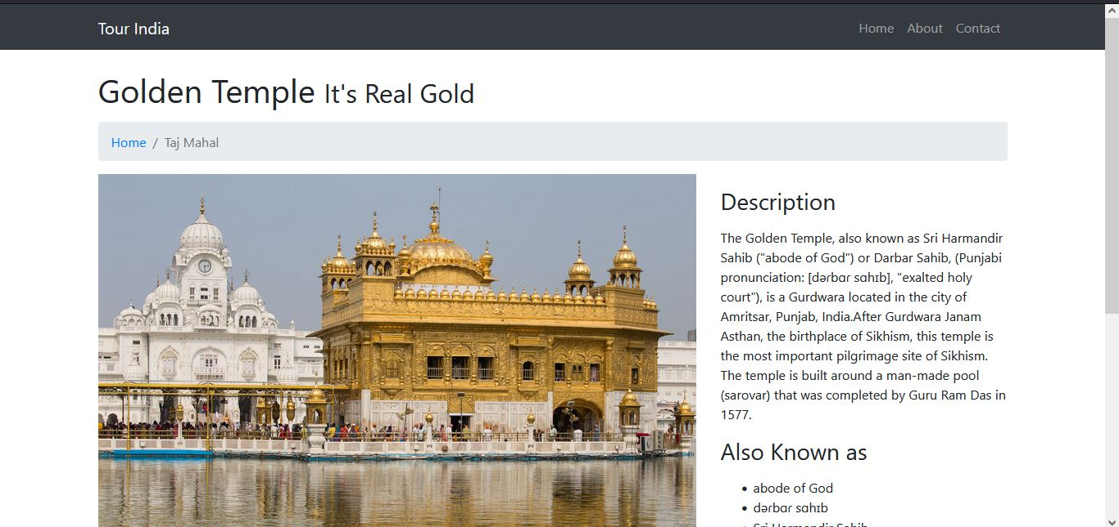

Slide 10
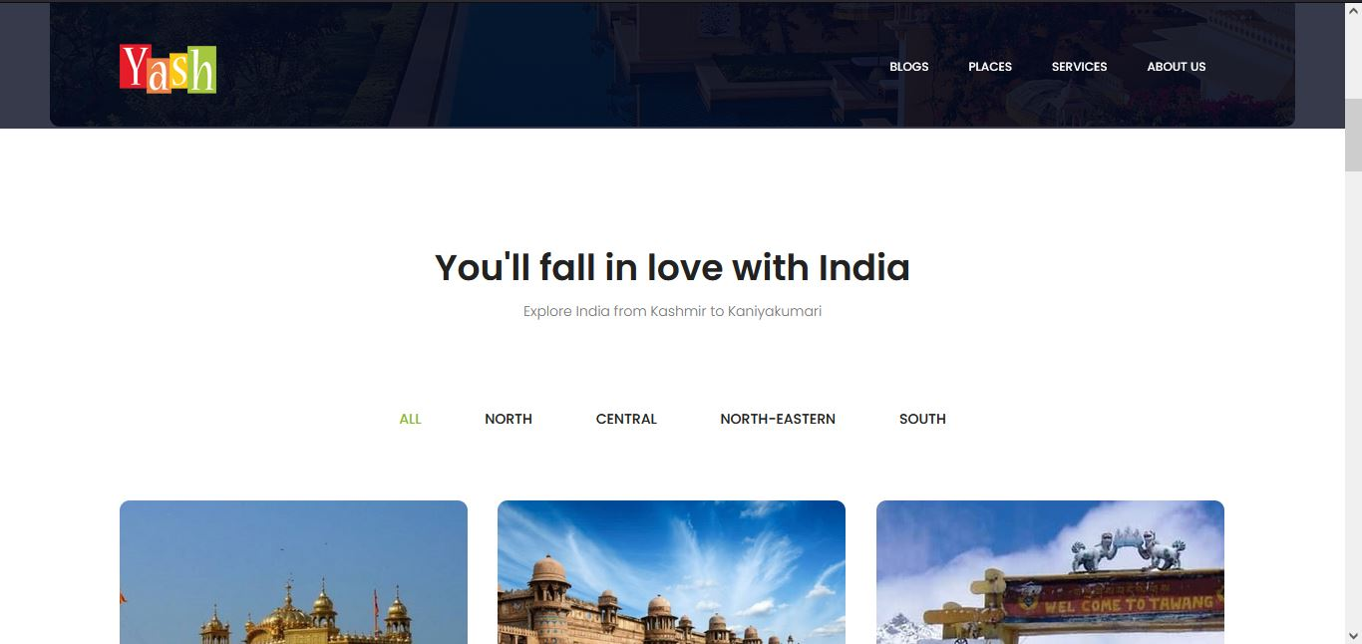

Slide 11
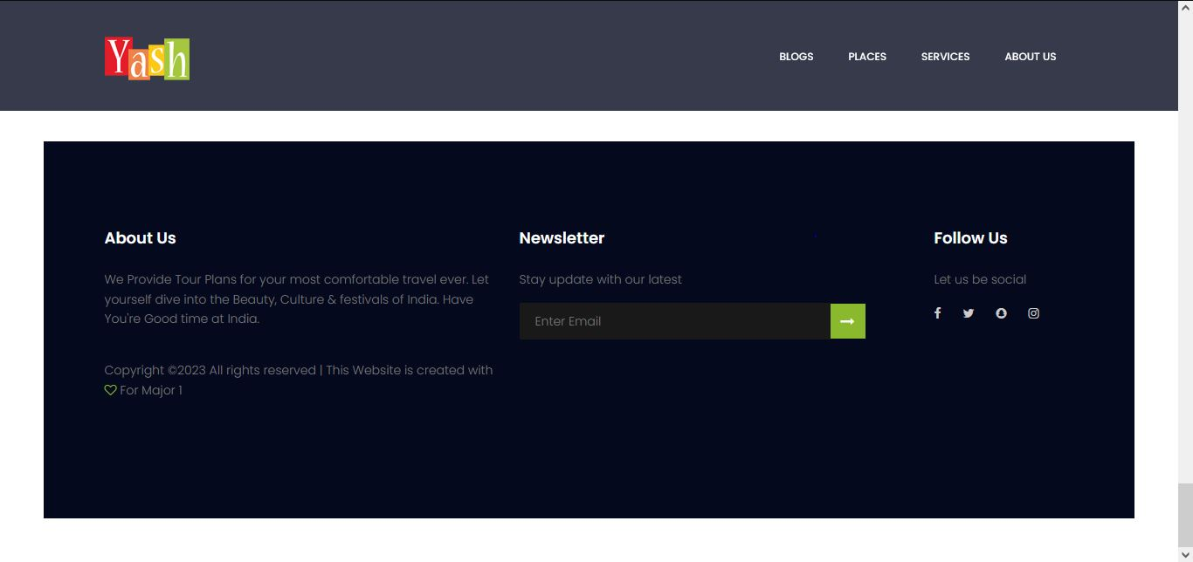

Slide 13
Conclusion
The Innovative Tourism Service Provider Evaluation System addresses challenges faced by tourists, including overcharging, fraud, and lack of transparency.
By promoting transparent practices and accurate information, the project enhances the overall tourism industry.
The system empowers travelers with reliable information, fostering trust and confidence in their choices of service providers.
Through responsible tourism, the project encourages ethical business practices, benefiting both tourists and local communities.
The project becomes a catalyst for positive change, promoting cultural exchange and global understanding.
By fostering an ecosystem of trust, the system ensures that travel becomes not only a source of joy but also a means of global cooperation.

Slide 14
Future Scope
Global Expansion: Extend the platform's reach to international destinations, facilitating cross-border travel and cultural exchange.
Integration of Emerging Technologies: Incorporate AR, VR, and AI-driven personalization for immersive experiences and tailored recommendations.
Environmental Sustainability: Promote eco-friendly tourism by partnering with green-certified accommodations and encouraging responsible travel practices.
Blockchain Integration: Implement blockchain technology for secure transactions and genuine user reviews, enhancing trust and transparency.
Mobile App Development: Develop user-friendly mobile applications for iOS and Android platforms, offering offline access, real-time notifications, and geolocation services.

Slide 15
References
https://tourism.gov.in/sites/default/files/2020-08/Safe%20and%20Honble%20Tourism%20Guidelines.pdf
https://vietnamtour.in/scams-in-vietnam-and-how-to-avoid/
https://www.aeaweb.org/articles?id=10.1257/002205106776162717
https://www.oecd.org/cfe/tourism/Safe-and-seamless-travel-and-improved-traveller-experience-OECDReport-for-the-G20-TWG_merged.pdf
https://consumer.ftc.gov/articles/how-avoid-scam
https://www.outlooktraveller.com/destinations/international/heres-your-guide-to-avoid-getting-scammed-on-your-travels-abroad
https://www.outlooktraveller.com/explore/ravel-style/a-handy-guide-to-avoiding-travel-scams
https://www.researchgate.net/publication/256987272_'RIPPING_OFF'_Tourists_An_empirical_evaluation_of_tourists'_perceptions_and_service_worker_misbehavior
https://www.insuremytrip.com/travel-advice/travel-safety/common-travel-scams-to-avoid/
https://www.researchgate.net/publication/287940508_Tourist_scams_Exploring_the_dimensions_of_an_international_tourism_phenomenon

